Slide 1
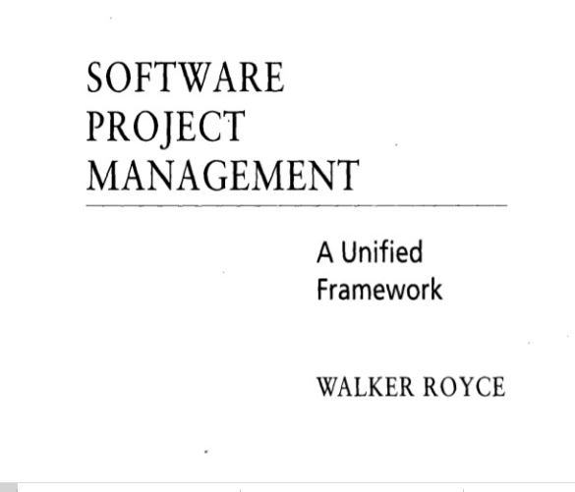
QUESTION-2
What does “Timeboxed” means in Agile terms?
A. Fast B. Flexible C. Frequent D. Fixed

Slide 2
Life-Cycle Phases
LIFE - CYCLE ASPECT | ENGINEERING STAGE EMPHASIS | PRODUCTION STAGE EMPHASIS
Risk reduction | Schedule, technical feasibility | Cost
Products | Architecture baseline | Product release baselines
Activities | Analysis, design, planning | Implementation, testing
Assessment | Demonstration, inspection, analysis | Testing
Economics | Resolving diseconomies of scale | Exploiting economics of scale
Management | Planning | Operations

Slide 3
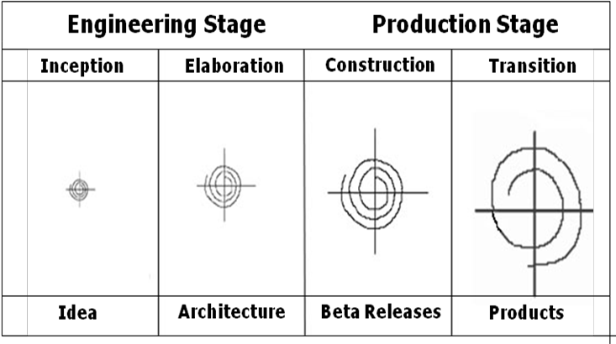
Life Cycle Stages

Slide 4
Inception Phase
Overriding goal of the inception phase is to achieve concurrence among stakeholders on the life- cycle objectives
Essential activities :
Formulating the scope of the project (capturing the requirements and operational concept in an information repository)
Synthesizing the architecture (design trade-offs, problem space ambiguities, and available solution-space assets are evaluated)
Planning and preparing a business case (alternatives for risk management, iteration planes, and cost/schedule/profitability trade-offs are evaluated)

Slide 5
Elaboration Phase
It is easy to argue that the elaboration phase is the most critical of the four phases. At the end of this phase, the “engineering “is considered complete and the project faces its reckoning. During the elaboration phase, an executable architecture prototype is built in one or more iterations, depending on the scope, size, risk and novelty of the project.
Essential activities:
Elaborating the vision (establishing a high-fidelity understanding of the critical use cases that drive architectural or planning decisions)
Elaborating the process and infrastructure (establishing the construction process, the tools and process automation support)
Elaborating the architecture and selecting components (lessons learned from these activities may result in redesign of the architecture)

Slide 6
Construction Phase
During the construction phase :
All remaining components and application features are integrated into the application
All features are thoroughly tested
Essential activities:
Resource management, control, and process optimization
Complete component development and testing against evaluation criteria
Assessment of the product releases against acceptance criteria of the vision

Slide 7
Transition Phase
The transition phase is entered when baseline is mature enough to be deployed in the end-user domain. This phase could include beta testing, conversion of operational databases, and training of users and maintainers.
Essential activities:
Synchronization and integration of concurrent construction into consistent deployment baselines
Deployment-specific engineering (commercial packaging and production, field personnel training)
Assessment of deployment baselines against the complete vision and acceptance criteria in the requirements set

Slide 8
Evaluation Criteria
Is the user satisfied?
Are actual resource expenditures versus planned expenditures acceptable?
Each of the four phases consists of one or more iterations in which some technical capability is produced in demonstrable form and assessed against a set of the criteria.
The transition from one phase to the nest maps more to a significant business decision than to the completion of specific software activity.

Slide 9
Process Artifacts
Life – cycle software artifacts are organized into five distinct sets that are roughly partitioned by the underlying language of the set:
management,
requirements,
design,
implementation, and
deployment.

Slide 10
Management set
The Management set captures the artifacts associated with process planning and execution. Management artifacts are evaluated, assessed and measured through a combination of the following:
a. Relevant stakeholder reviews
b. Analysis of changes between the current version of the artifact and previous versions
c. Major milestone demonstrations of the balance among all artifacts and in particular, the accuracy of the business case and vision artifacts.

Slide 11
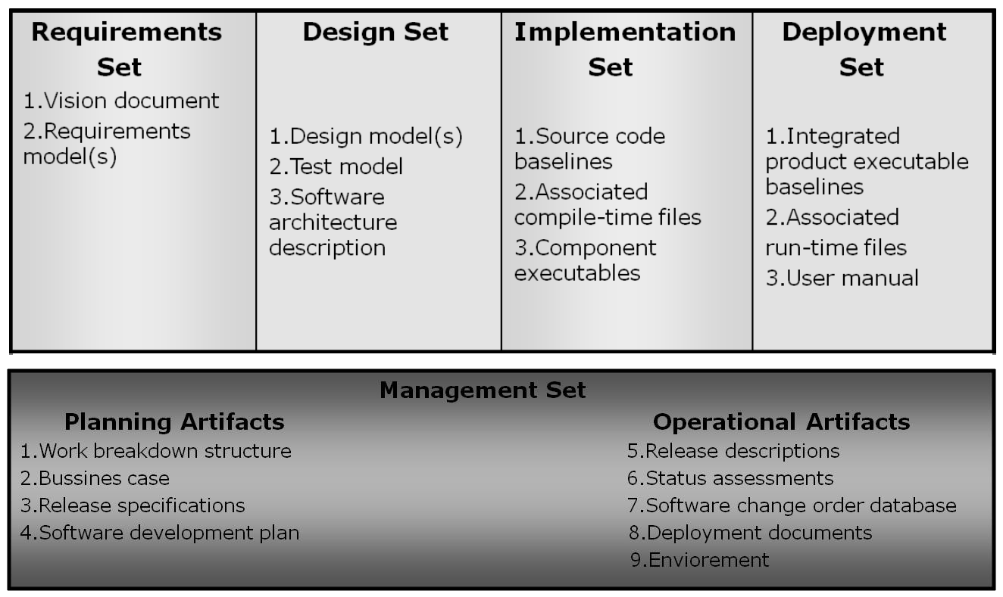
The Engineering Sets:
The engineering sets consist of the requirements set, the design setk the implementation set, and the deployment set.

Slide 12
Management artifacts
The management set includes several artifacts
Work Breakdown Structure –
vehicle for budgeting and collecting costs. The software project manager must have insight into project costs and how they are expended. If the WBS is structured improperly, it can drive the evolving design in the wrong direction.
Business Case –
provides all the information necessary to determine whether the project is worth investing in. It details the expected revenue, expected cost, technical and management plans.
Release Specifications

Slide 13
Business CASE OUTLINE

Slide 14
SOFTWARE DEVELOPMENT PLAN OUTLINE

Slide 15
RELEASE SPECIFICATION OUTLINE:

Slide 16
RELEASE DESCRIPTION OUTLINE:

Slide 17
VISION DOCUMENT OUTLINE

Slide 18
ARCHITECTURE DESCRIPTION OUTLINE

Slide 19
ARTIFACT SEQUENCES ACROSS A TYPICAL LIFE CYCLE

Slide 20
▪Vision statement - which captures the contract between the development group and the buyer.
▪Evaluation criteria – defined as management-oriented requirements, which may be represented by use cases, use case realizations or structured text representations.
➢ Software Development Plan – the defining document for the project’s process. It must comply with the contract, comply with the organization standards, evolve along with the design and requirements.
➢ Deployment – depending on the project, it could include several document subsets for transitioning the product into operational status. It could also include computer system operations manuals, software installation manuals, plans and procedures for cutover etc.
➢ Environment – A robust development environment must support automation of the development process.
It should include: requirements management
visual modeling
document automation
automated regression testing

Slide 21
Engineering Artifacts:
In general review, there are three engineering artifacts:
Vision document – supports the contract between the funding authority and the development organization.
It is written from the user’s perspective, focusing on the essential features f the system.
It should contain at least two appendixes – the first appendix should describe the operational concept using use cases, the second should describe the change risks inherent in the vision statement.
Architecture Description – it is extracted from the design model and includes views of the design, implementation, and deployment sets sufficient to understand how the operational concept of the requirements set will be achieved.

Slide 22
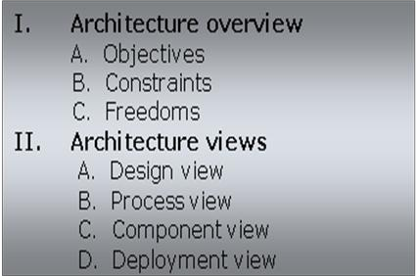
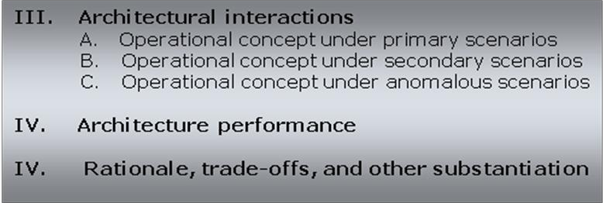
Typical architecture description outline

Slide 23
Pragmatic Artifacts
People want to review information but don't understand the language of the artifact.
Many interested reviewers of a particular artifact will resist having to learn the engineering language in which the artifact is written. It is not uncommon to find people (such as veteran software managers, veteran quality assurance specialists, or an auditing authority from a regulatory agency) who react as follows: "I'm not going to learn UML, but I want to review the design of this software, so give me a separate description such as some flowcharts and text that I can understand."
People want to review the information but don't have access to the tools.
It is not very common for the development organization to be fully tooled. it is extremely rare that the/other stakeholders have any capability to review the engineering artifacts on-line. Consequently, organizations are forced to exchange paper documents. Standardized formats (such as UML, spreadsheets, Visual Basic, C++, and Ada 95), visualization tools, and the Web are rapidly making it economically feasible for all stakeholders to exchange information electronically.

Slide 24
Pragmatic Artifacts
•Human-readable engineering artifacts should use rigorous notations that are complete, consistent, and used in a self-documenting manner
Properly spelled English words should be used for all identifiers and descriptions. Acronyms and abbreviations should be used only where they are well accepted jargon in the context of the component's usage. Readability should be emphasized and the use of proper English words should be required in all engineering artifacts. This practice enables understandable representations, browse able formats (paperless review), more-rigorous notations, and reduced error rates.
•Useful documentation is self-defining
It is documentation that gets used.
•Paper is tangible; electronic artifacts are too easy to change
On-line and Web-based artifacts can be changed easily and are viewed with more skepticism because of their inherent volatility.
.

